Slide 1



Web Application Stack Technology
z
System Administration Appreciation Day 2023

Slide 2






Sengphachanh SIPHAXAI (Ham)
System Administration Appreciation Day 2023
Application Solution Architect, CSC
28 July 2023

Slide 3
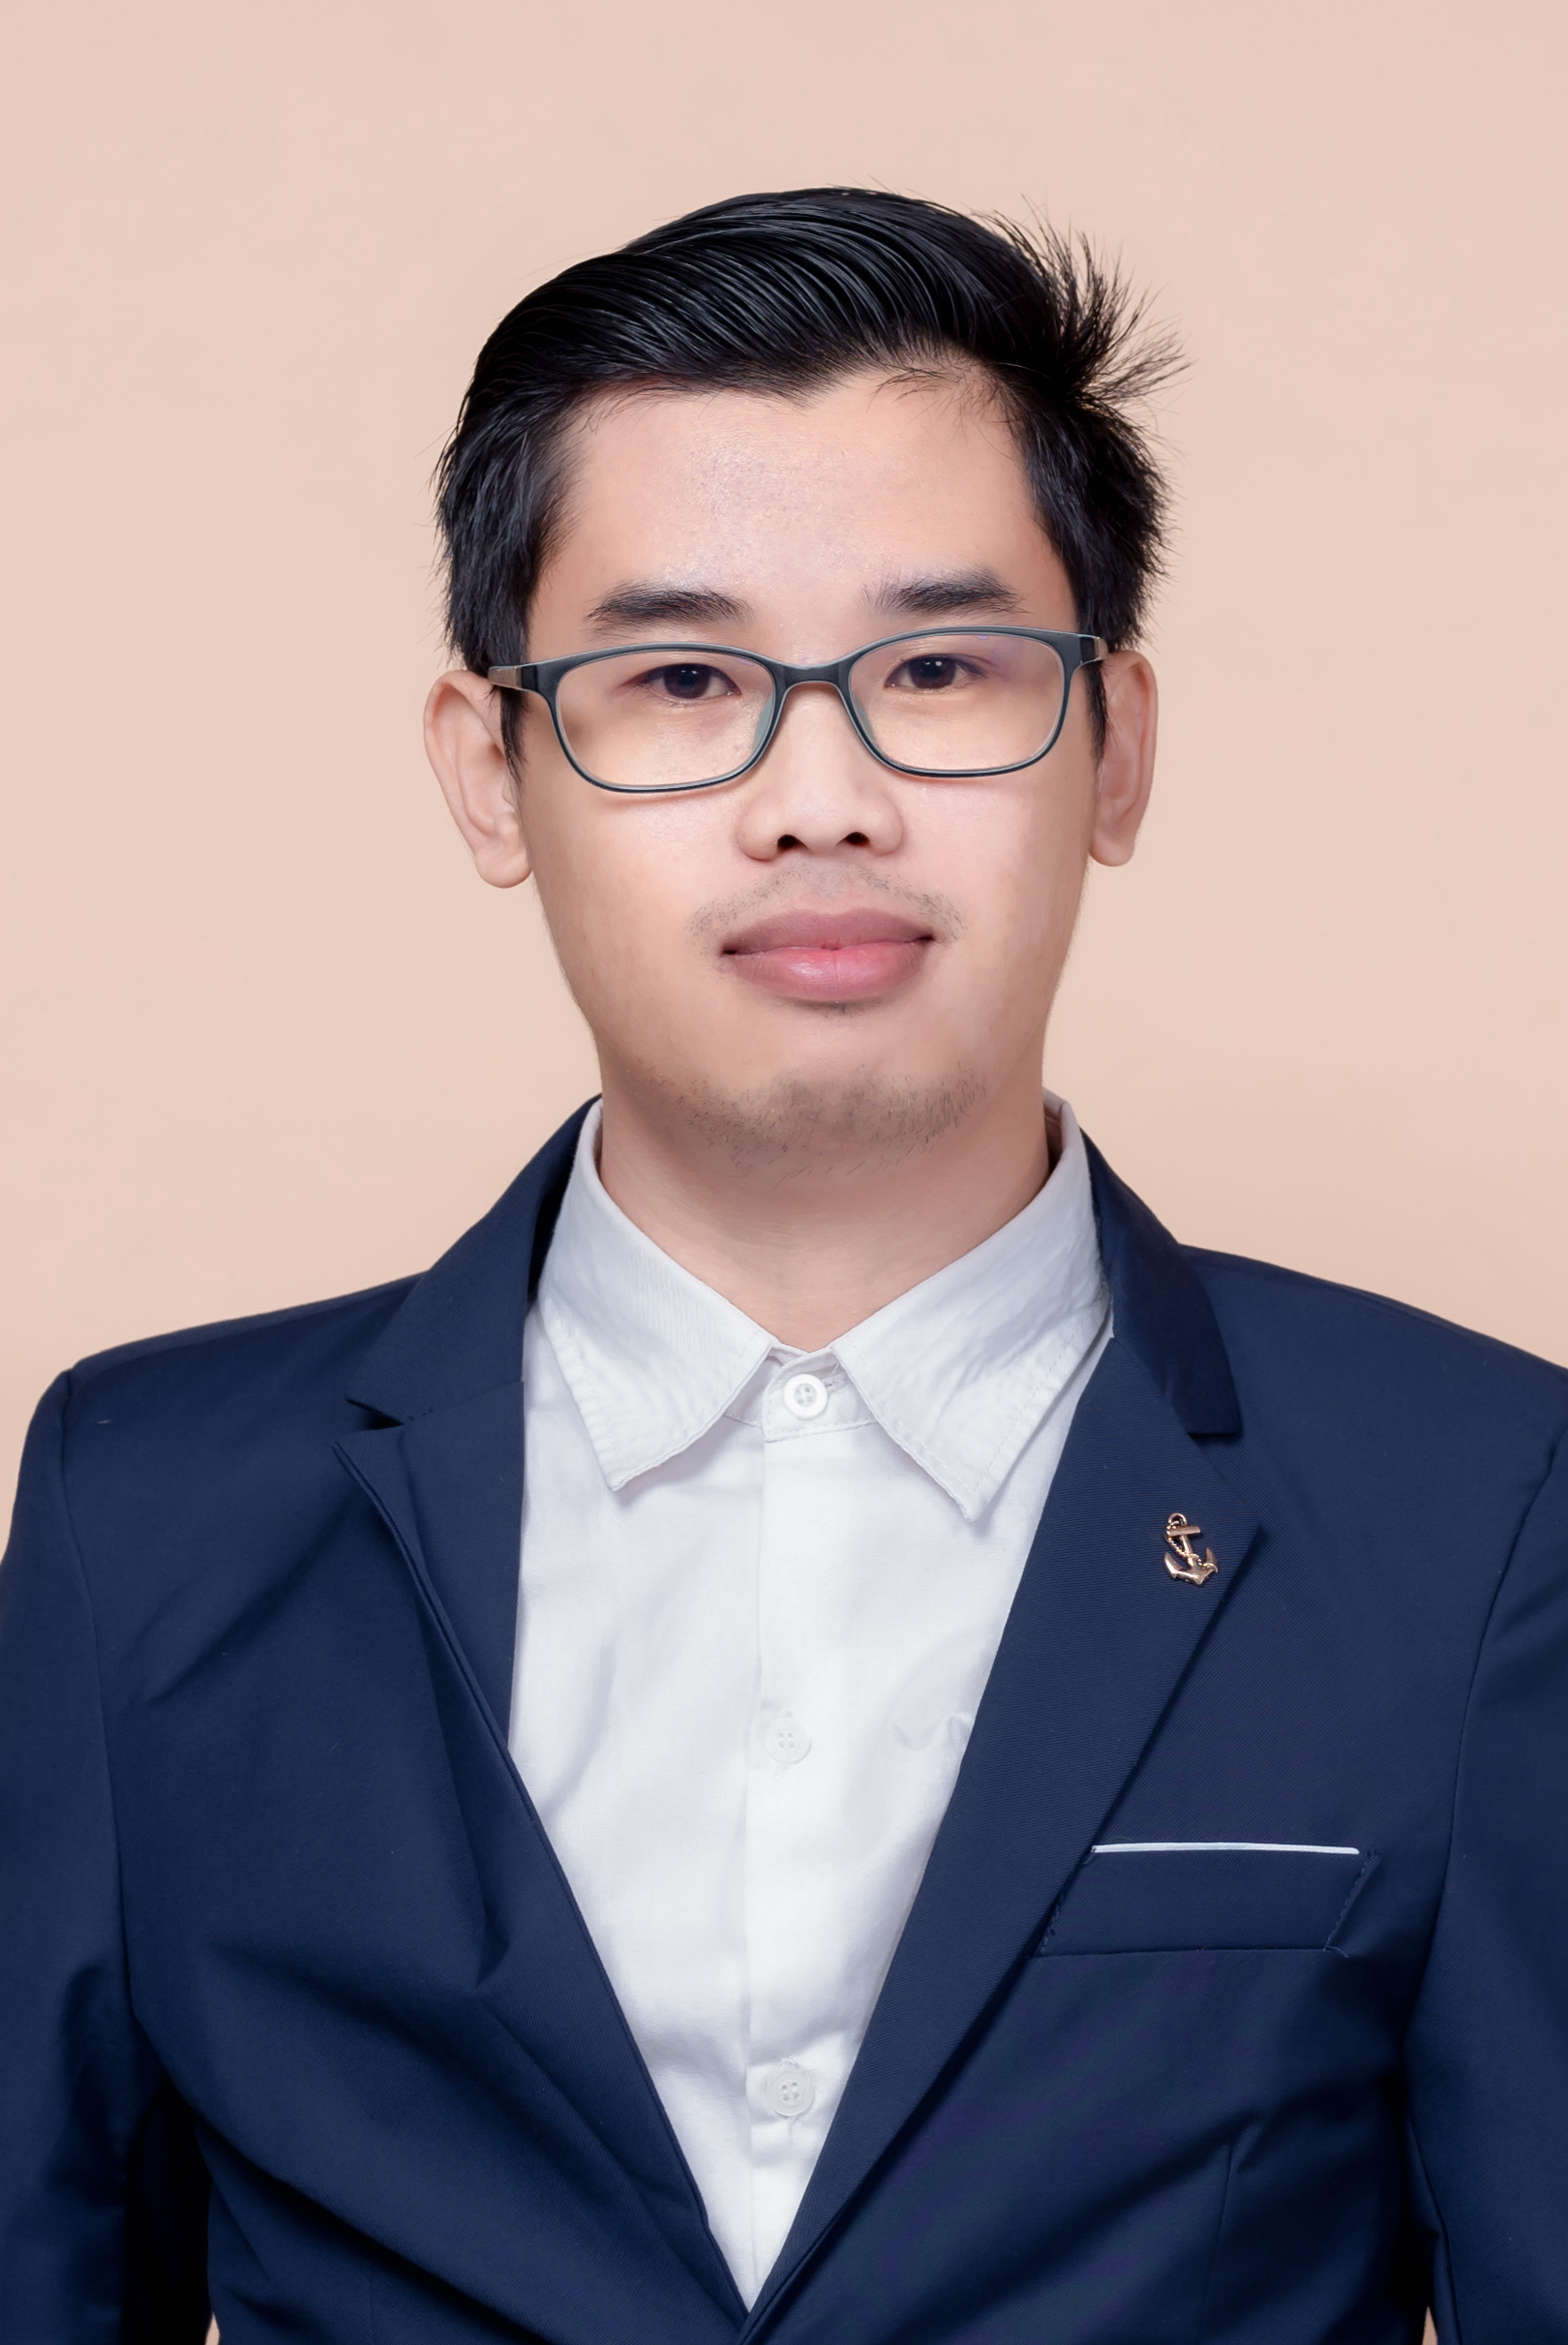



Sengphachanh SIPHAXAI (Ham)
Education
2019-2021 | Bachelor Degree of Information Technology Faculty of Engineering.
2016-2019 | Higher Diploma of Information Technology Management Quest College.

Slide 4

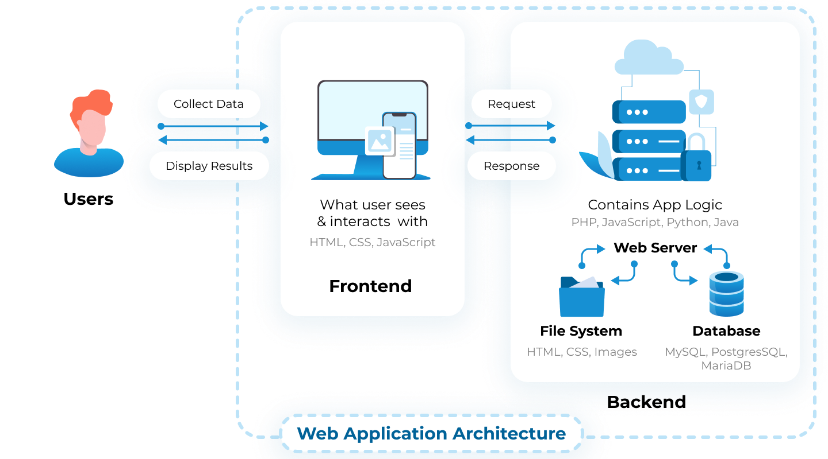



How Web Application Work

Slide 5





















Our Technology
Backend
Frontend
Database
Other

Slide 6





#
Accessibility
Efficient development
User Simplicity
Scalability

Slide 7
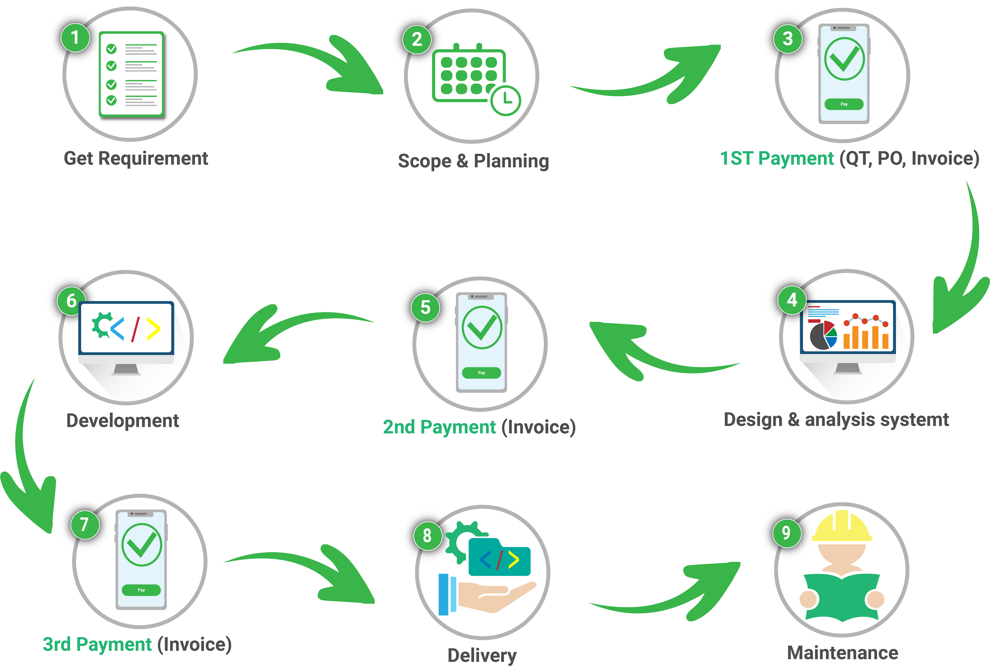
Our Work Process

Slide 8





Our Customers
HRD

Slide 9
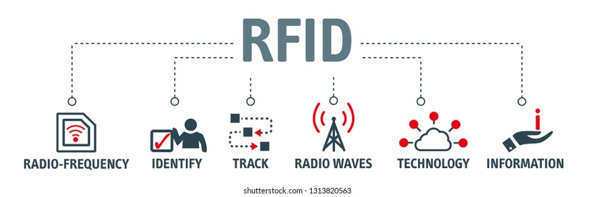
Other Technology

Slide 10
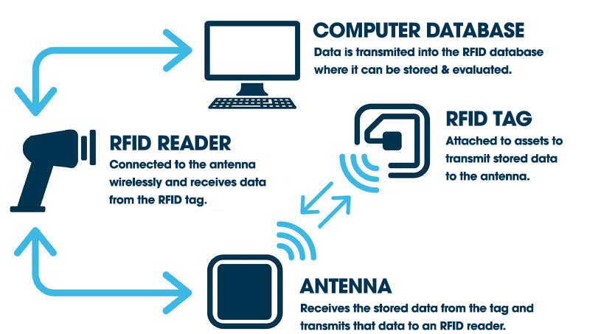
How RFID Work

Slide 11
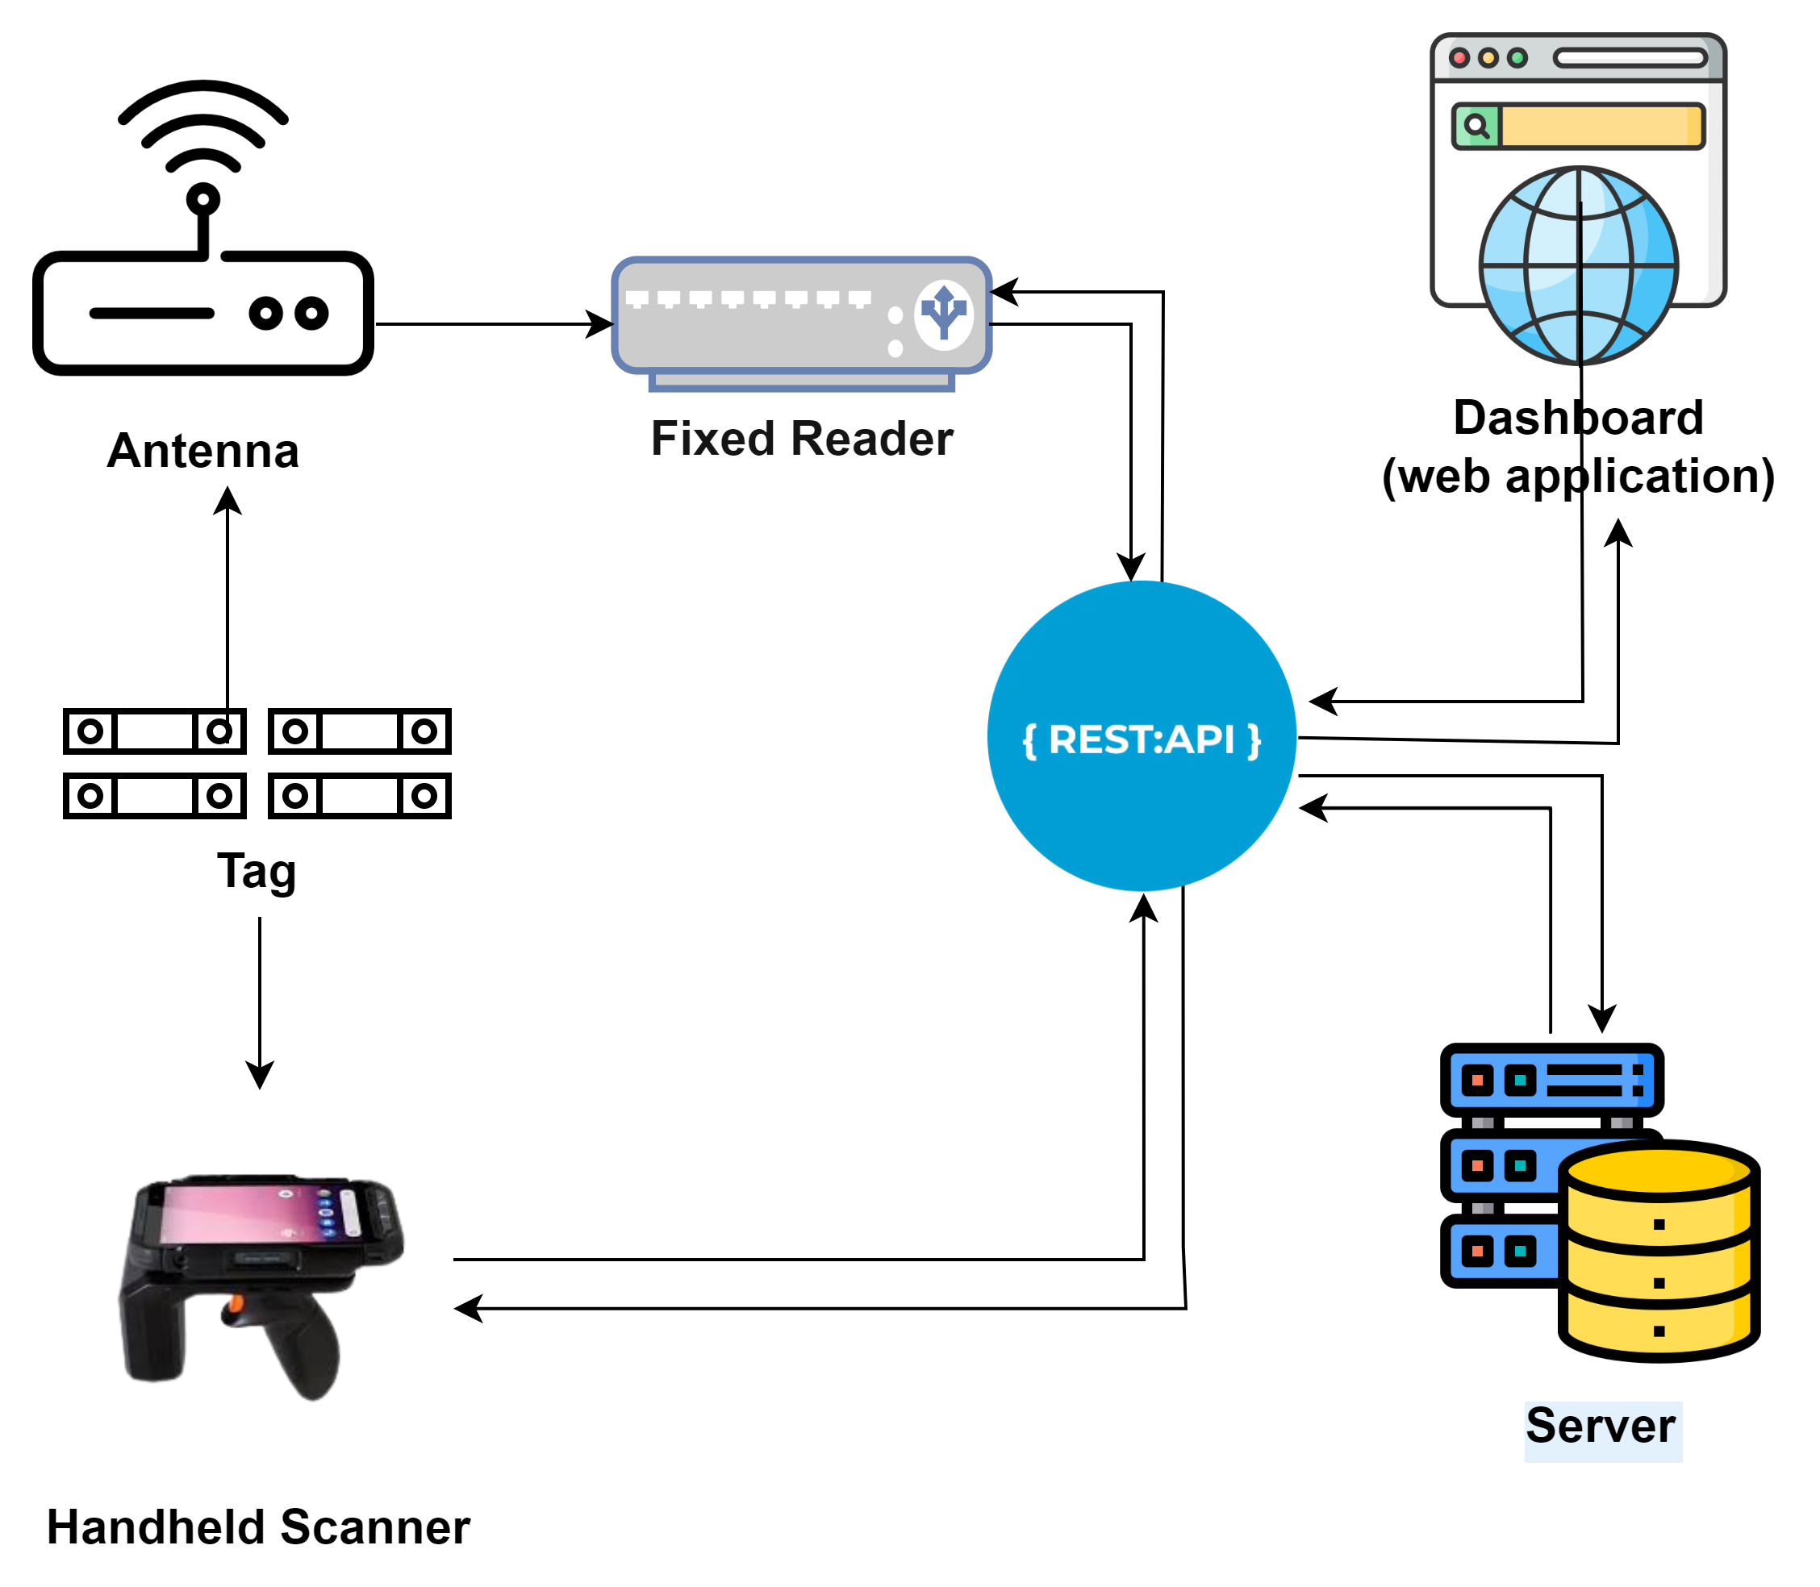
How RFID Work With Web Application

Slide 12


Summary

Slide 13



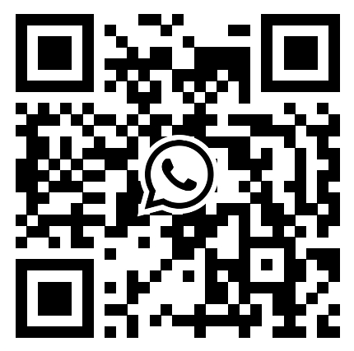
Sengphachanh SHIPHAXAI
(Ham)
Contact
+856 20 98673246
Sengphachanh@verisette.com

